Slide 1
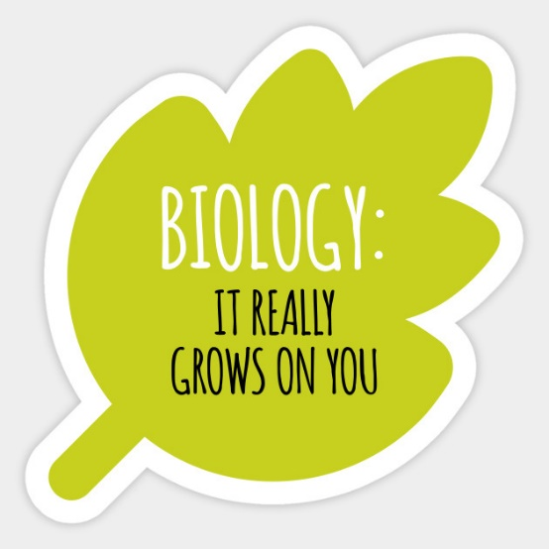


biology
Sixth Form Virtual Open Evening
Mrs. B. Harrison & mrs.c.taylor
Ysgol Uwchradd
Llanidloes
High School

Slide 2
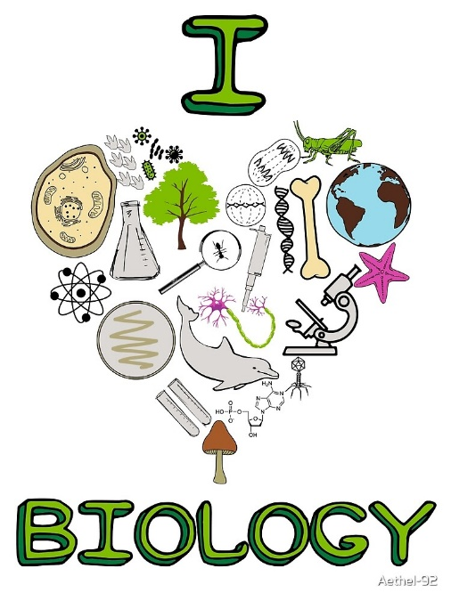
Why study biology at llanidloes high school?
As a Biology student, no longer will you take for granted the true wonders of life and the natural world, as you will be able to understand the fascinating medical and scientific processes behind them
With all of the ground breaking knowledge you will acquire and absorb, you could be just the person to drive forward changes in medicine, sport science, nutrition, environmental science, microbiology, agriculture, veterinary science, equine sciences, immunology, crop sciences to name a few.
Studying biology requires you to think laterally and critically, problem solve, carry out detailed practical tasks, memorize and apply detailed scientific knowledge.
Biology results at Llanidloes High School have been good/excellent for many years.
Biology is taught by teachers with many years experience of teaching this wondrous subject.

Slide 3

Course description
The A level course for Biology is studied in five units.
AS units studies in Year 12
Unit 1 – Biochemistry and Cell Organization
Unit 2 – Biodiversity and Physiology of Body Systems
A2 units studied in Year 13
Unit 3 – Energy, Homeostasis and the Environment
Unit 4 – Variation, Inheritance and options (Immunology and Disease, Human Musculoskeletal Anatomy or Neurobiology and Behaviour)
Unit 5 – Practical examination which involves an experimental task and a practical analysis task.
There is no coursework in Biology. All units are assessed by external exams.

Slide 4

assessment
The five units are assessed in the following way:
Year 12
Unit 1 – 1hour 30min examination 20% of the qualification.
Unit 2 – 1hour 30min examination 20% of the qualification.
Year 13
Unit 3 – 2 hour written exam 25% of the qualification.
Unit 4 – 2 hour written exam 25% of the qualification.
Unit 5 – Practical examination 10% of the qualification.
To continue studying Biology as A2 a minimum of a C grade needs to be attained as AS.

Slide 5

Career progression and subject combinations
Naturally, studying Biology at A level leads the way to a career in Medicine along with other medically based subjects such as:
Microbiology Midwifery
Physiology Nursing
Physioitherapy Animal husbandry
Osteopathy Podietry
Dentistry Epidemiology
Veterinary sciences Medical research
Animal sciences Pharmacologist

Slide 6
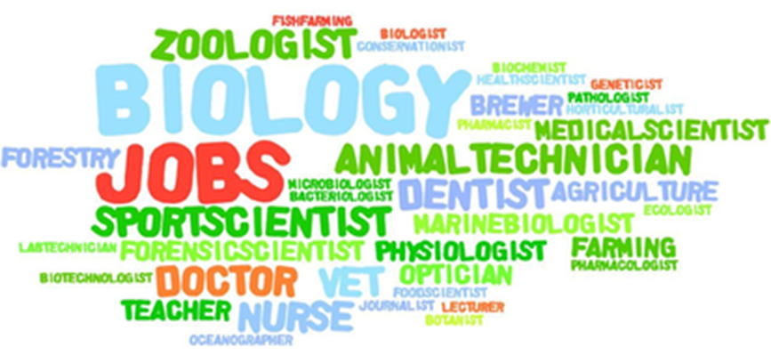
Career progression and subject combinations
Biology may also lead to a career in the following:
Ecology Crop science
Marine Biology Agriculture
Zoology Genetics
Environmental biology Forestry
Botany Patholagist
Forensic scientist Sports scientist
Nutritionist Conservationist
Which ever career path you choose, studying A level Biology gives you the skills needed to succeed in a vast array of exciting life opportunities.

