Slide 1
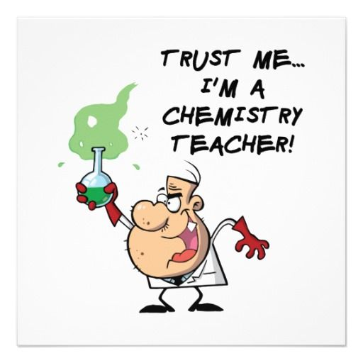


A-Level
CHEMISTRY
Sixth Form Virtual Open Evening
Mr. M. YOUNG/ MRS. A. Bevan-HaNSoN
Ysgol Uwchradd
Llanidloes
High School
Notes:
Good Evening and welcome to the presentation for A-Level Chemistry at Llanidloes High School. I am Mr. Young, Head of Chemistry, and I will go through this presentation with you.
The purpose of this presentation is to provide an insight of the A-Level Chemistry course, provisions that we provide, within the subject, at Llanidloes High and comments from current and previous A-Level students that have chosen Chemistry at Llanidloes High.

Slide 2

Why study chemistry at Llanidloes high?
Chemistry is a study of the substances found on earth, in living things and used by humans. It helps us understand how these substances behave and seeks to develop improvements. It links scientific evidence with theory and encourages logical thinking.
A good chemist requires the ability to use abstract concepts, some mathematical skills and a good memory for detail.
Chemistry results at A-Level in Llanidloes High School have been very good/excellent for many years.
It is taught by teachers who have experience in using Chemistry in industry, passing on their knowledge and skills to students.
Notes:
Why study Chemistry at Llanidloes High?
For many years, Chemistry has been a very popular subject amongst pupils. They enjoy carrying out experiments and gain many skills, that will assist them in all subjects they study, as well as the outside world.
The subject is delivered by experienced staff, who have dedicated themselves to the subject and ensuring that students of Chemistry achieve the best possible grades.
For a significant number of years, Chemistry class sizes have been in double figures, reflecting the enthusiasm students have towards the subject.
Generally, Chemistry would be suitable for students who are taking GCSE Science at Higher tier although in recent years, students who have attained a high grade at Foundation tier are also accepted to study.
It is important that students have good numeracy skills, so a good GCSE in Mathematics is also an advantage but not essential.

Slide 3
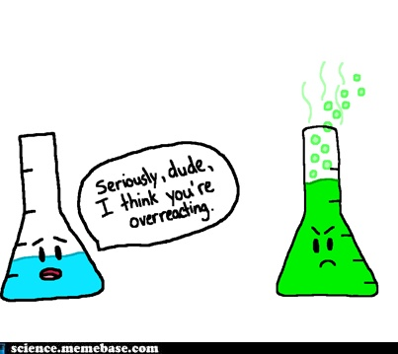
Course description
The A-Level course for Chemistry is broken down into five units:
Unit 1 – The Language of Chemistry, Structure of Matter & Simple Reactions
Unit 2 – Energy, Rate and Chemistry of Carbon Atoms
Unit 3 – Physical and Inorganic Chemistry
Unit 4 – Organic Chemistry and Analysis
Unit 5 – Practical & Controlled Assessment
Notes:
Course Description
The A-Level Chemistry course is studied over a two year period.
In year 12, there are two units of study.
Unit 1 looks at the Basic Introduction to AS Chemistry i.e. the Atom, Moles Calculations, Structures, Bonding, Acid-Base Reactions & the Periodic Table. This mainly focuses on Physical & Inorganic Chemistry aspects of the course.
Unit 2 looks at Organic Chemistry and Energy reactions such as Hydrocarbons, Halogenoalkanes, Alcohols, Spectroscopy, Enthalpy Changes and Rates of Reaction.
In Year 13, there are three units.
Unit 3 looks further at Physical and Inorganic Chemistry where specific Groups of the Periodic table are studied, Entropy reactions, acid-base equilibria and redox reactions.
Unit 4 look at other aspects of Organic Chemistry mainly aldehydes and ketones, amines, aromatic compounds, carboxylic acids, NMR spectroscopy.
Unit 5 is a Practical Assessment, which consists of a three hour practical task, testing your child’s practical skills, as well as a one hour assessment based on practical skills and knowledge that they have learnt throughout the two years.

Slide 4
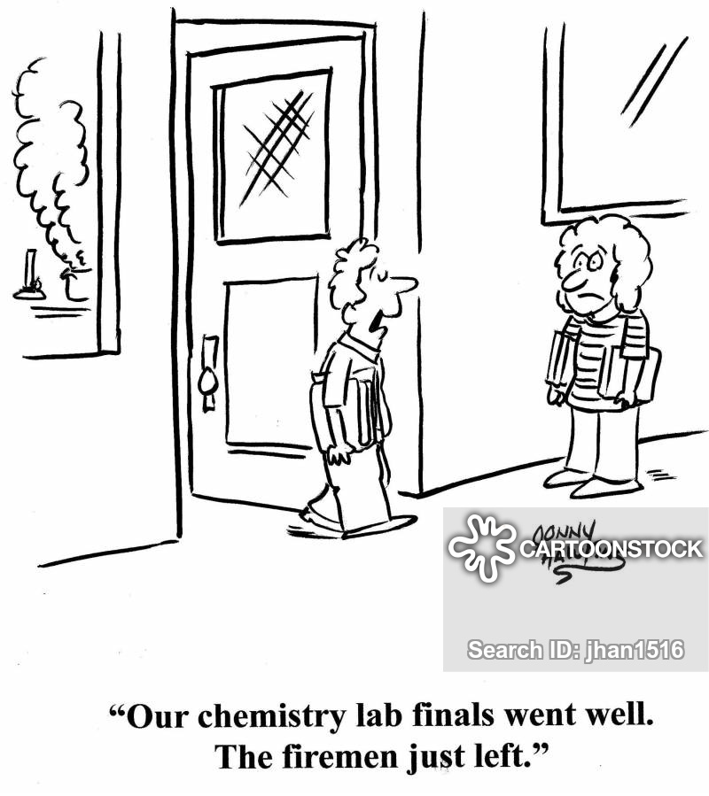

Assessment outline
Year 12 = 40% of the overall grade
Year 13 = 60% of the overall grade
Notes:
In year 12, there are two examinations, each unit is worth 20% of the overall grade.
Each unit exam last for one and a half hours and marked out of 80.
In Year 13, there are three examinations, both Units 3 & 4 are worth 25% each of the final grade, whilst Unit 5 is 10%. All units are an extension and an increase in detail and depth of the topics studied in Year 12, hence the greater percentage.
Unit 5 is a Practical Assessments that contribute to the final 10%.
Therefore, 40% of the grade consists of Year 12 Units and 60% of the overall grade in Year 13. To attain a good overall grade, it is generally advised that the students attain a minimum C grade in the Year 12 examinations. If they are unable to get this grade, the chances of attaining a high grade in Year 13 is reduced, although we have allowed students with lower grades in year 12 and have over-achieved.
There are opportunities for students to resit the Year 12 exams, which have also been proved successful, in attaining a higher grade.

Slide 5
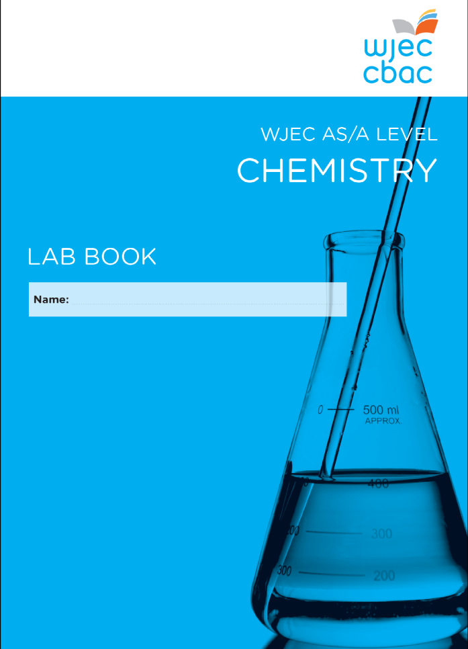
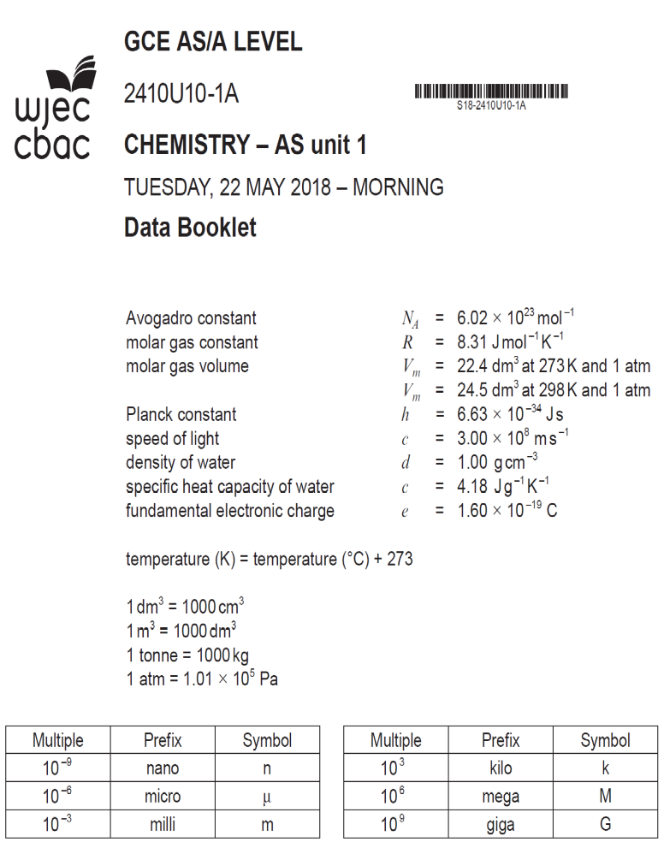
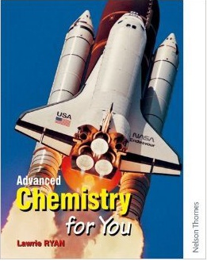
What students receive when taking chemistry?
Notes:
When your child begins their journey of Chemistry in the sixth form, we will provide them with a number of useful resources and documents.
They will be given a data booklet, which contains the Periodic table and other useful pieces of data, that are beneficial towards their learning.
A copy of the A-Level Specification, outlining the areas of study that will be carried out during the course.
A lab book, which contains specified practical tasks that the examination board will expect to be carried out throughout the period of the course. Examinations will contain questions based on certain practicals, within the booklet, and are monitored by an external invigilator during a visit.
Finally, we provide a copy of Advances Chemistry for You, that provides a good understanding of topics that have been taught within the classroom. It contains past paper questions, to test you child’s knowledge.
As well as the previously mentioned resources, we provide online and electronic resources for your child to access such as powerpoints, past papers, homework tasks.

Slide 6
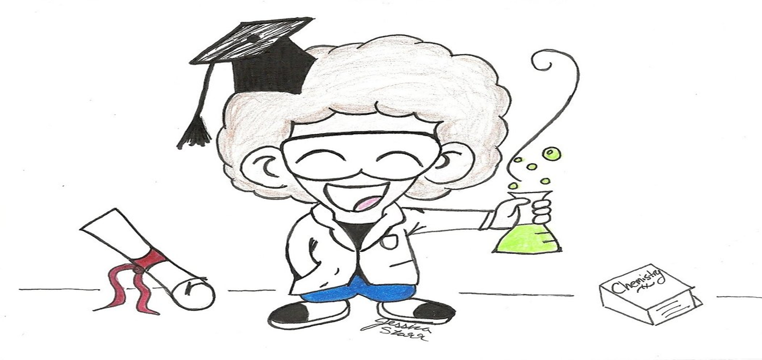
Career progression and subject combinations
Chemistry fits in well with Physics, Biology, Geography and Maths. It is useful for the scientific careers including medical and environmental. The majority of chemists have careers outside the subject as their thinking abilities are respected in many commercial and managerial jobs.
Notes:
Chemistry offers a wide range of careers for individuals to follow, whether it is the medical, pharmaceutical, industrial, environmental or educational.
Many careers use practical, numeracy, problem solving, interpersonal and intrapersonal skills that have been gained from studying Chemistry into their line of work.
In general, Chemistry works very well with all other sciences, as well as Mathematics and Geography. Although, there is no limit for Chemistry to work alongside other subjects that are studied at Llanidloes High School.

Slide 7
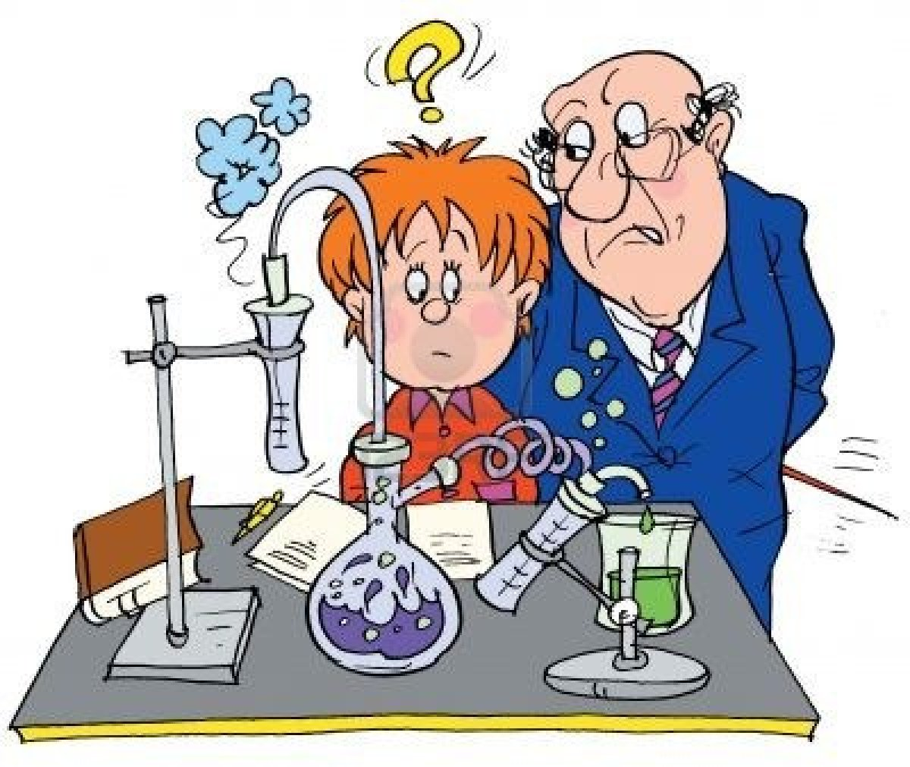
Why take chemistry at a-level??
“I enjoyed it during GCSE. It was easily my favourite science. I needed a science or maths A Level for the job that I wanted in the future.”
Year 13 Student
“I learn about chemical treatments for humans, how it works and how chemistry plays a pivotal role in modern day society.”
Year 12 Student
“In the Chemistry lessons, I get tips and common errors that arise in questions.
I am able to communicate with the teachers via different platforms eg teams/email/in person ”
Year 12 Student
“I chose Chemistry as it is a required A-Level to study dentistry. I am able to use the skills I’ve learnt in Chemistry in some of my other subjects such as Maths & Biology, which is an advantage over other students within those subjects”
Year 12 Student
Notes:
Here are some comments from current and previous students that have chosen to study Chemistry at Llanidloes High School.

Slide 8
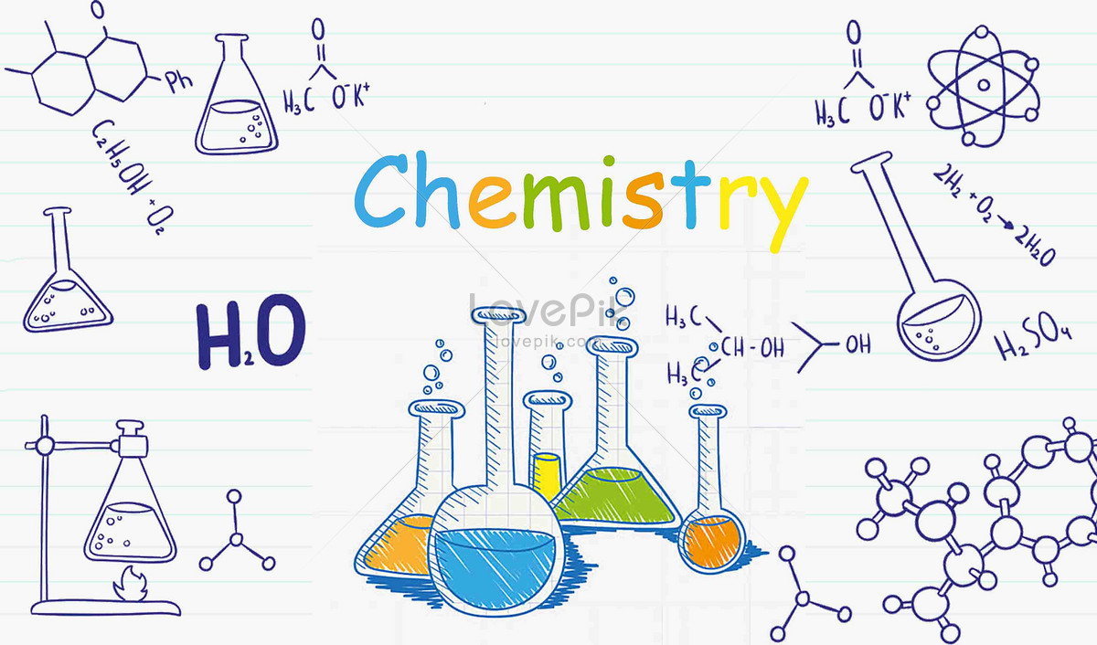
Any QUESTIONS???
If you have any further questions regarding the subject, please speak to Mr. Young at the Virtual Webinar.
WJEC Website: www.wjec.co.uk/qualifications/chemistry-as-a-level
Notes:
Should you have any questions or queries regarding the AS & A-Level Course, please get in contact and I would be happy to assist.
Thank you very much for listening to this presentation and look forward to seeing you soon.

