Slide 1

Product design
Sixth Form Virtual Open Evening
Dr E Palfrey
Ysgol Uwchradd
Llanidloes
High School

Slide 2
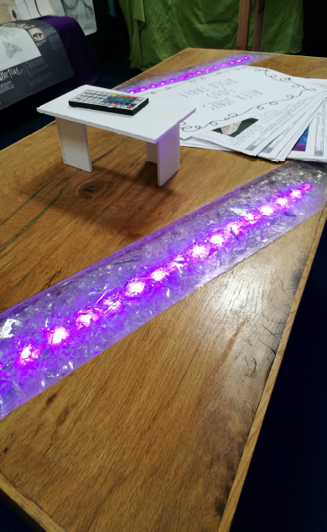
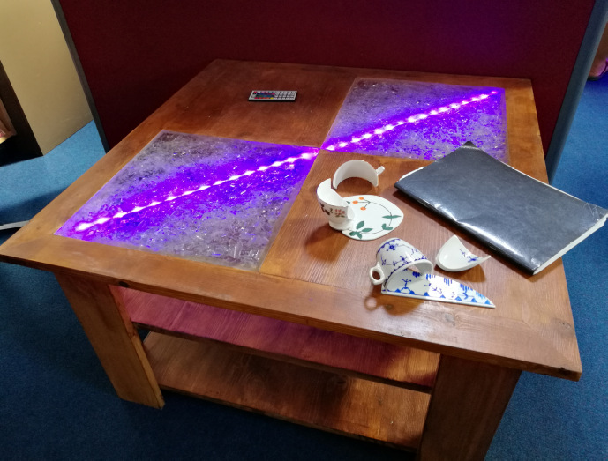
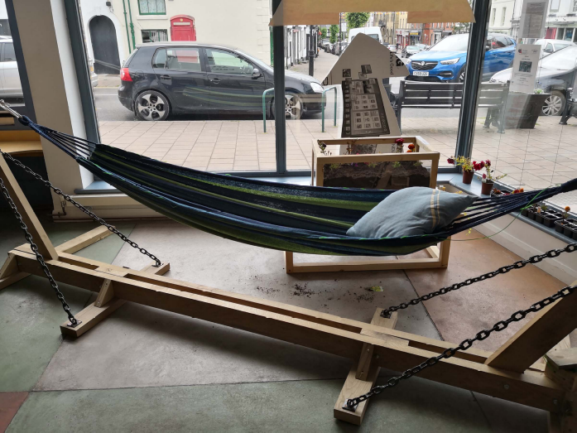
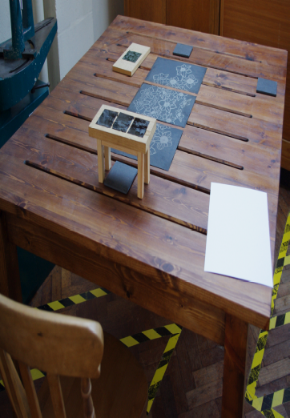
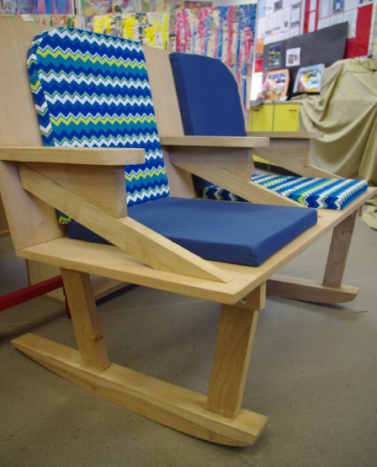
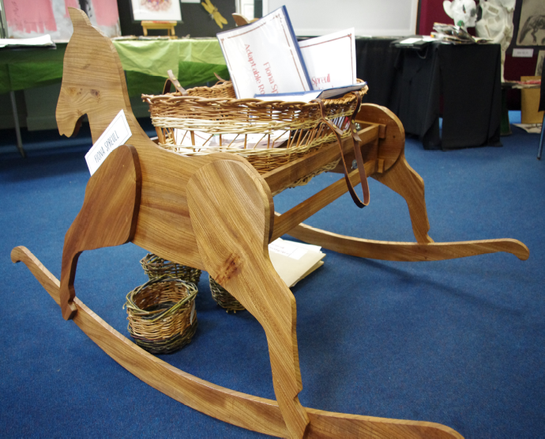
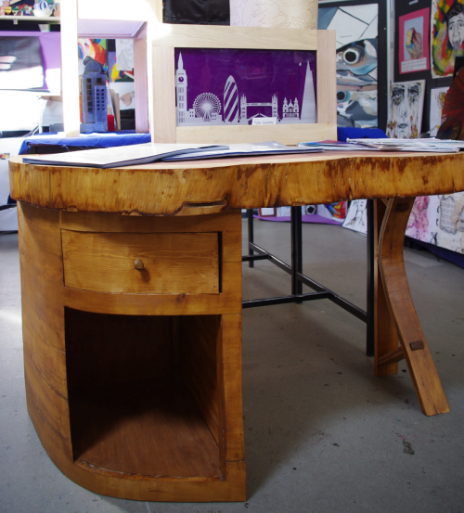
Why study Product design?
Product Design gives you the opportunity to demonstrate your creative side. We’ve had all kinds of projects, some fairly traditional, and some definitely not!

Slide 3
Course description
Studying Product Design encourages students to become creative and innovative problem solvers.
Throughout the course, students develop their understanding of industrial and commercial practice, including sustainability and environmental issues, gaining an insight into the broader issues related to design across a variety of industries.
For the coursework aspect, students will fully investigate a number of contexts, in order to identify opportunities to develop a new product.
Students are able choose the contexts which best suit their personal area, or areas, of interest within the subject; whether that may be Graphics, Resistant Materials, Electronics or Textiles....or a combination of all four!

Slide 4
Assessment: AS Level
Unit 1: Written paper 2 hours – 50% of AS Level
The examination includes a mix of structured and extended writing questions assessing students’ knowledge and understanding of technical principles, designing and making principles, along with their ability to analyse and evaluate design decisions and wider issues in design and technology.
Unit 2: Non-exam assessment: approximately 40 hours 50% of AS Level
A design and make task, based on a brief developed by the students, assessing their ability to:
  Identify, investigate and outline design possibilities.
  Design and make prototypes.
  Analyse and evaluate design decisions and wider issues in design and technology.

Slide 5
Assessment: A Level
Unit 3: Written paper 2 Written examination: 50% of A Level
The examination includes a mix of structured and extended writing questions assessing students’ knowledge and understanding of technical principles, designing and making principles, along with their ability to analyse and evaluate design decisions and wider issues in design and technology.
Unit 4: Non-exam assessment: approximately 60 hours 50% of A Level
A sustained design and make project, based on a brief developed by the students, assessing their ability to:
  Identify, investigate and outline design possibilities.
  Design and make prototypes.
  Analyse and evaluate design decisions and wider issues in design and technology.

Slide 6
subject combinations
Product Design is a great all-round subject; it involves finding realistic solutions to everyday problems. An A Level in Product Design shows prospective employers or further/higher education tutors that you have the ability to be a problem-solver.
For those of you opting for a traditional, academic route you may choose to study Product Design alongside Mathematics, Physics and Engineering, where it can provide a welcome break from the structured classroom lessons and allow you to take a more creative approach.
Product Design also compliments the more creative side of school life, working particularly well with an A Level in Art.
Within Product Design we look at the commercial side of the industry, so combining this subject with Business Studies is another great combination.

Slide 7
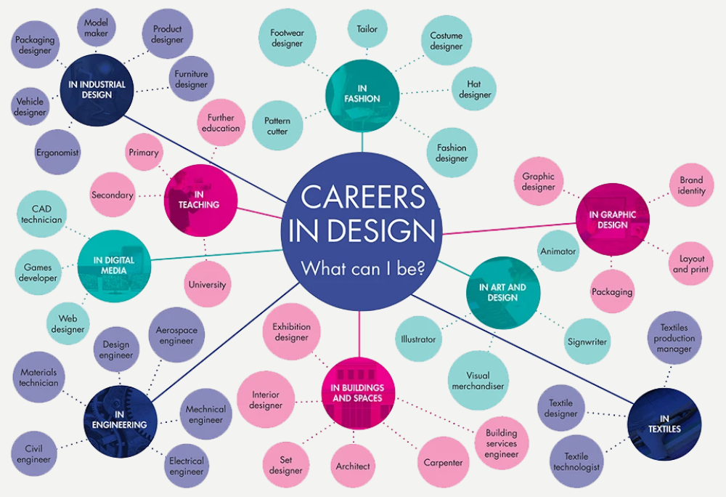
Career progression
Product Design can help you pursue a career in a wide variety of fields.
The options listed here give you a flavour of what would be available to you…

