Slide 1


A Level History
Sixth Form Virtual Open Evening
Mr J Jones and Mr A Morel
Ysgol Uwchradd
Llanidloes
High School

Slide 2
Why study History?
55% of students got an A* or and A in 2019!!
History is a serious academic discipline and regarded as one of the 9 ‘Gold Standard’ subjects by Russell Group universities.
History is one of the Russell Group universities’ ‘facilitating’ subjects — so called because choosing it at A-level allows a wide range of options for degree study.
This intellectually rigorous course is an excellent way for students to develop highly sought after and transferable skills.
These include being able to effectively communicate complex ideas, the ability to research, analyse and evaluate information, both orally and in writing, and the capacity to make substantiated judgements, all whilst developing independent work skills.
https://www.youtube.com/watch?v=Y01i9ehkA6g&feature=youtu.be

Slide 3
Course description
“The teaching is inspirational, and opens our minds to the mysteries of the past.”
Those who pursue the course will develop specific skills. Besides increasing their understanding of the Early Modern and Modern World, they will learn to argue cogently, communicate effectively, develop the ability to analyse and synthesise both ideas and information and to reach logical conclusions. It is not a course requirement that students should have undertaken History at GCSE. In fact, in recent years, we have had a number of students achieve very well at A Level history, despite not taking it at GCSE.

Slide 4
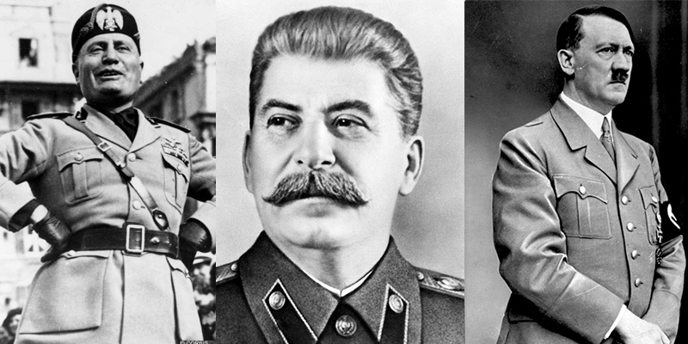
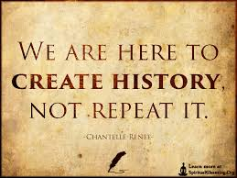
What will you study with us?
AS Unit 1 - Period Study
The first course will be a period study of Europe from c1890 – 1990. This charts the changing international relations between European nations from the Berlin Congress to the Cold War. Specific topics such as the rise of National Socialism (Nazi-ism) in Germany, Fascism in Italy and Communism in Russia and life under these new ideologies are amongst the most fascinating elements of the course.
Assessment:
1 hour 30 minutes written exam (20% of the A-level) at the end of Year 12

Slide 5
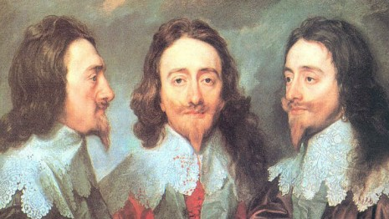
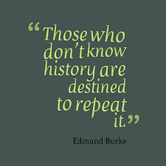
What will you study with us?
AS Unit 2 — Depth Study
Unit 2 takes us back to the 17th century with a study of the main events, individuals and actions leading up to the beginning of the Civil War in 1642. Political intrigue, bad decision making and sheer ‘skulduggery’ make this a fascinating unit of study which is both engaging and highly accessible.
Assessment:
1 hour 30 minutes written exam (20% of the A-level) at the end of Year 12

Slide 6
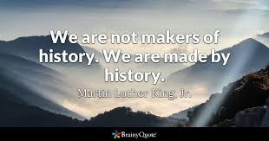
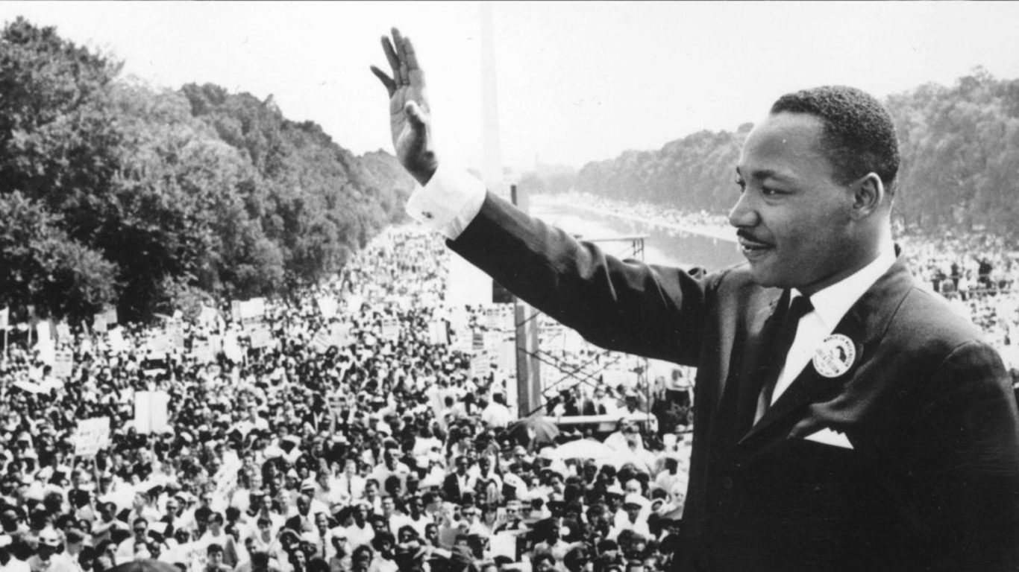
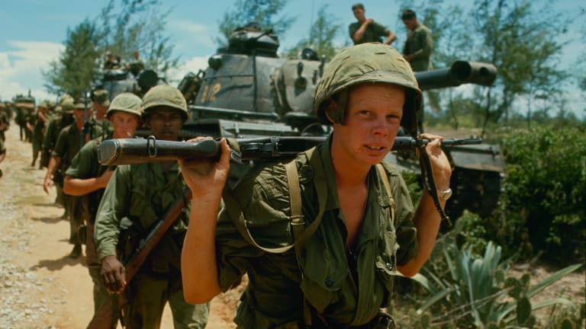
What will you study with us?
A2 Unit 3 - Breadth Study
Moving on to A2 we take an in depth look at race relations and foreign policy in the USA 1900-2000. Civil rights, Martin Luther King and the Black Power movement all feature heavily in this highly emotive and contextually relevant unit of study. In addition, looking at the USA’s developing role in world affairs after WWII gives our students a superb understanding of how the current dynamic in global politics came into being.
Assessment:
1 hour 45 minutes written exam (20% of the A-level) at the end of Year 13

Slide 7
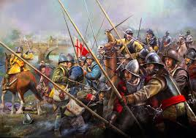
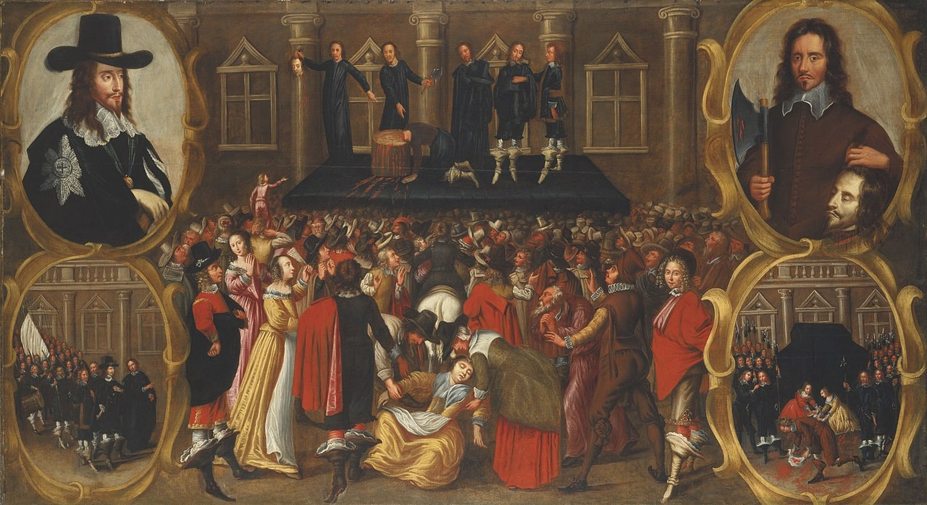
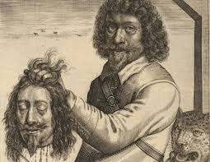
What will you study with us?
A2 Unit 4 - Depth Study
The depth study continues with a study of the Civil War itself, focusing on the key events and factors that decided the outcome of the conflict. Unit 4 goes on to look at the search for a settlement between Parliament and the King after 1646 and looks at why the failure to settle ultimately led to the King’s trial and execution. Focus on the failed attempts to govern from 1649 to 1660 and the Restoration of the monarchy complete our study of this amazing period in our history.
Assessment:
1 hour 45 minutes written exam (20% of the A-level) at the end of Year 13

Slide 8
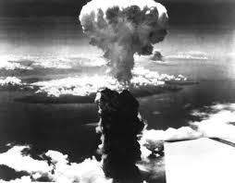
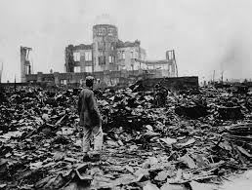
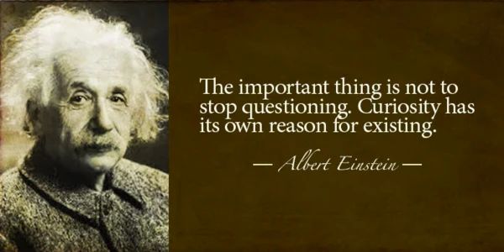
Controlled assessment
A2 Unit 5 - Historical Interpretations non-examined assessment (NEA)
Students will need to complete a 3000-4000 word assignment (20% of the A-level) on an aspect of the Cold War. Full support and guidance are given throughout and this is a great way for students to boost their overall grade.
Previous assignments have focused on the USA’s justifications for dropping the atomic bombs on Japan in 1945.

Slide 9
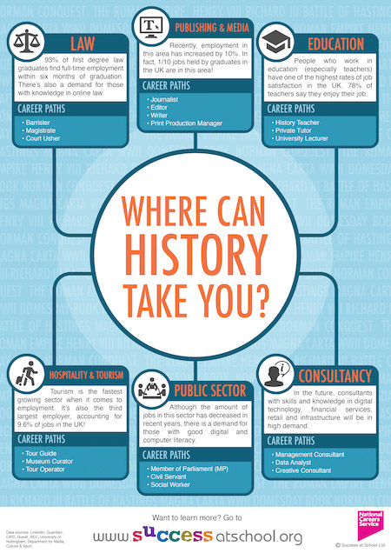
Career progression

Slide 10
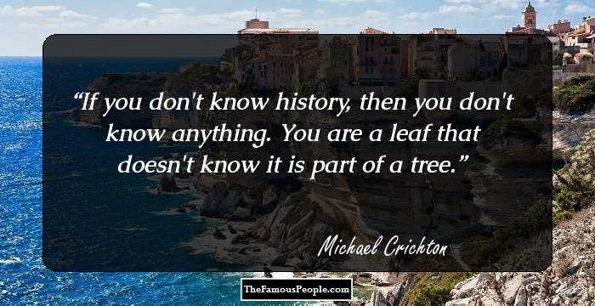
Goes well with………….
As a ‘facilitating’ subject, History goes with just about everything. We’ve even had historians go on to study medicine!
That said, history seems to compliment the following subjects:
Politics
Geography
English
Criminology
Classics
Art
Law

