Slide 1

Information Technology
Sixth Form Virtual Open Evening
Led by dan craig
Ysgol Uwchradd
Llanidloes
High School

Slide 2

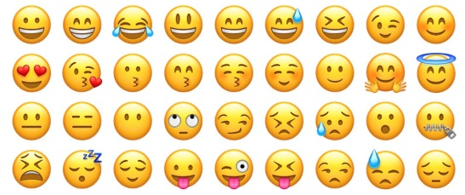
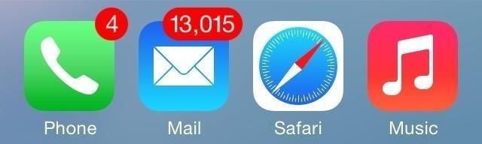
Why study Information technology?
The future world will be divided into those who understand technology and those who have to pay them for their knowledge. The former governor of the Bank of England, Mark Carney, stated that within 20 years up to half of all jobs in the UK will be lost to AI systems and robots.
Why study Information Technology? Because the future excites you. Because you know that there will be new jobs, new opportunities, new ways of life. Because you want to be part of the technological revolution. Because you love being able to keep in touch with your friends through social media. Because you love all the things your phone can do. Because you love computer games and CGI, augmented and virtual reality, the development of robots, drones, AI systems and chatbots. Because you embrace the new!

Slide 3

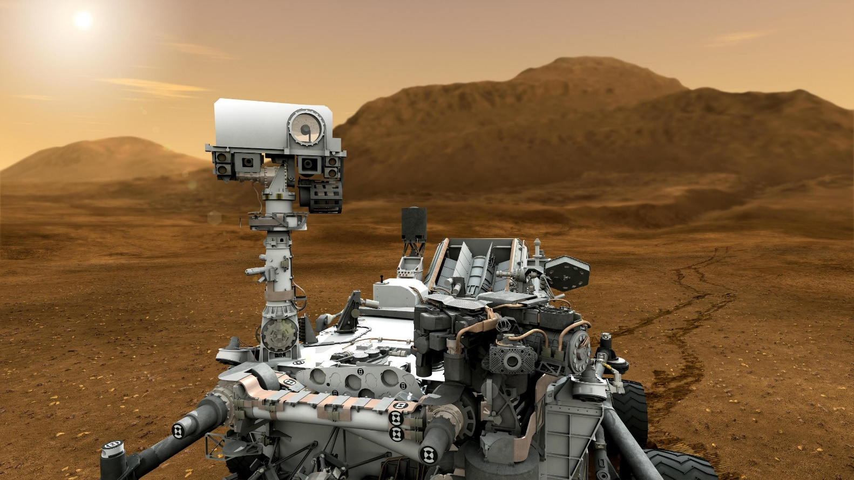
Course description
Cambridge Technicals are vocational qualifications that are designed to give you a work-focused alternative to A Levels. They’ve been designed to give you opportunities to demonstrate and develop the practical application of knowledge and understanding in the areas of work that appeal to you. This will enable you to develop your research skills as you work, both independently and with colleagues, to progress through your qualifications. The assessment for the qualifications is task-based, so you won’t need to take exams to achieve Cambridge Technicals qualifications.
If you prefer to learn in a way that’s practical and work-related, then Cambridge Technicals are ideal. The great thing about them is that they keep your options open – so if you’re not fully convinced that a vocational way of learning is right for you, Cambridge Technicals keep the door open for a move to higher education further down the line.

Slide 4
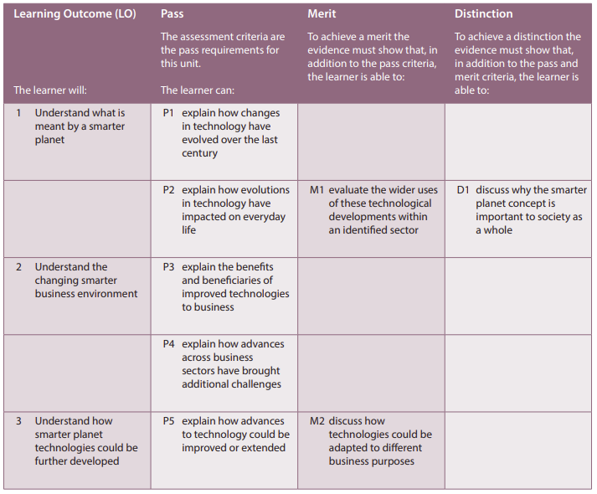
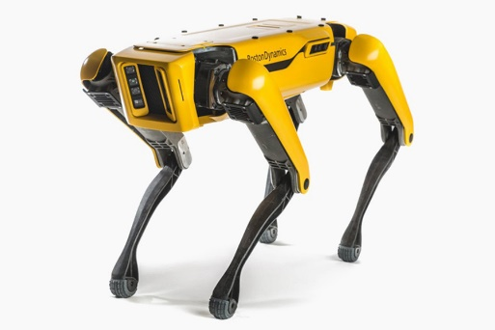
assessment
Students may complete the three unit Certificate, which is an ‘AS’ Level equivalence, or the six unit Introductory Diploma, which is an ‘A’ level equivalence.
The student may attain a Pass, Merit or Distinction on each unit A majority of Distinctions across units will gain an overall Distinction*, equivalent to an A* ‘A’ Level. The past two years 100% of students were awarded a Distinction or Distinction*.
Each unit is internally assessed by the teacher and then externally moderated. There are no exams. Students have to meet the criteria as shown on the left in optional unit 42 – Developing a Smarter Planet. There are two mandatory units to be taken in each qualification, and 41 optional units to choose from. See the units here - Units

Slide 5
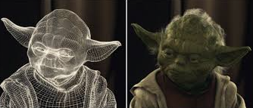
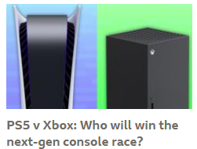
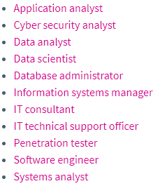
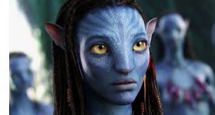
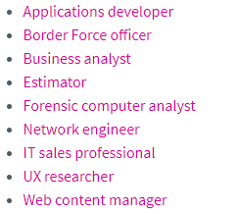
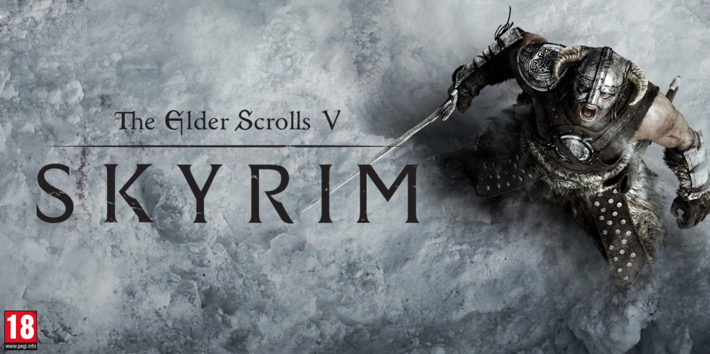

Career progression and subject combinations
IT may be studied as a specialist subject, or it may be studied as a facilitating subject, meaning it can complement a variety of other subjects by providing necessary skills and knowledge in communications.
The majority of organisations depend on the design, implementation and management of IT. As an information systems graduate, your skills will be invaluable to employers from a range of sectors.
Why do I want to teach IT? Click the button if you want to hear my answer.

