Slide 1


Libf personal finance
Sixth Form Virtual Open Evening
Dr. S. Creasey
Ysgol Uwchradd
Llanidloes
High School

Slide 2






Why study personal finance?
Develop key employability skills
e.g. problem-solving, communication,
research and resilience
Leads to diverse qualification
which branches across a wide range of disciplines
Increase knowledge and understanding
of the importance of personal finance and the finance and banking sectors
CV
Excellent preparation
for a wide range of
university courses
£
Support the study of
other A levels
Stimulating and challenging courses

Slide 3
Course description
Certificate in Personal Finance (AS Level equivalent)
Unit 1 – Financial Capability for the Immediate and Short Term (50%)
62.5%
Pure Mathematics
62.5%
Unit 2 - Financial Capability for the Medium and Long Term (50%)
18.75%
Statistics
18.75%
Two examinations: Multiple choice (35 marks; 45 min]; Case study [65 marks; 1h 45 min]
Two examinations: Multiple choice (35 marks; 45 min]; Case study [65 marks; 1h 45 min]
Diploma in Personal Finance [A Level equivalent]
Unit 3 – Sustainability of an Individual’s Finances (50%)
62.5%
Pure Mathematics
62.5%
Unit 4 – Sustainability of the Financial Services System (50%)
18.75%
Statistics
18.75%
Two examinations: Multiple choice (35 marks; 45 min]; Case study [65 marks; 1h 45 min]
Two examinations: Multiple choice (35 marks; 45 min]; Case study [65 marks; 1h 45 min]

Slide 4
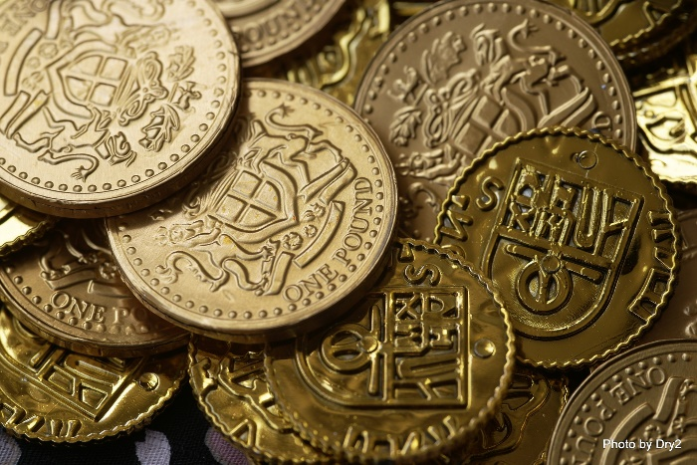

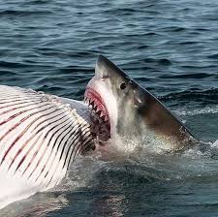
What topics do we study?
Unit 1 covers 12 topics including…
Consumer rights and protection
Money
Saving and Borrowing

Slide 5



What topics do we study?
Unit 1 covers 12 topics including…
Financial Legislation & Regulation
Financial Products and their Properties
Financial Life Cycle

Slide 6

Career progression and subject combinations

Slide 7
SUBJECTS THAT COMBINE WITH FINANCIAL STUDIES
Economics
Business studies
Financial Studies
Mathematics

