Slide 1


PHYSICS-A Level
Sixth Form Virtual Open Evening
Mr S EALEY-fITZGERALD
Ysgol Uwchradd
Llanidloes
High School

Slide 2
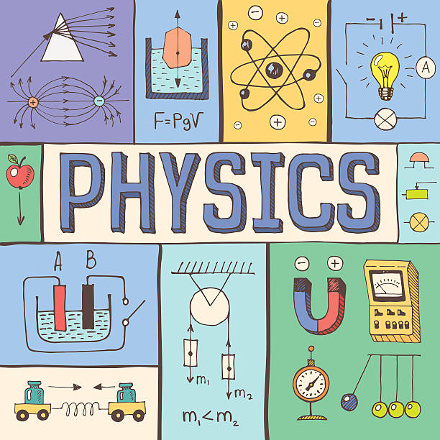
Why study physics?
Physics is a “facilitating subject” - it is highly regarded whatever degree or career path you choose. It’s considered essential for science and engineering courses, so it keeps a lot of doors open for you.
Physics opens these doors because of the skills and ways of thinking it teaches you. You’ll pick up skills that are valued in a huge range of careers
You’ll become a critical and creative thinker, and a problem solver.
You will develop skills in mathematical reasoning, theoretical deduction, experimentation and observations, computing, technology, materials and information theory.
As a result of these abilities, you will be sought after for a wide range of careers, including careers in finance, economics, statistics, engineering, computer science medicine, communications technology, space exploration and many other areas.

Slide 3

What will I study?
You will study the fundamentals of physics. These include quantum and classical mechanics, electromagnetism, statistical physics and thermodynamics, wave phenomena and the properties of matter.
You will also study atomic physics, nuclear and particle physics, materials, and fluids.
At A2 level you will be given the option to choose from one of four option topics to complete your studies.
Astronomy and space
VFX and gaming
Engineering
Climate science and meteorology
Renewable energy
Robotics and AI
Medical physics and digital healthcare
Law
Finance
Education
Journalism

Slide 4
Course description
AS Level- Year 12
Unit 1: MOTION, ENERGY, MATTER
Unit 2: ELECTRICITY and LIGHT
A Level- Year 13
Unit 3: OSCILLATIONS and NUCLEI
Unit 4: FIELDS and OPTIONS
(choose from)
A: Alternating currents
B: Medical physics
C: The physics of sports
D: Energy and the environment
Unit 4: PRACTICAL EXAMINATION
Experimental Task
Practical Analysis Task

Slide 5
Assessment
AS Level- Year 12
Unit 1: MOTION, ENERGY, MATTER 20%
Unit 2: ELECTRICITY and LIGHT 20%
A Level- Year 13
Unit 3: OSCILLATIONS and NUCLEI 25%
Unit 4: FIELDS and OPTIONS 25%
Unit 5: PRACTICAL EXAMINATION 10%

Slide 6
subject combinations
It is strongly recommended (however not required) that you also study Mathematics.
Other Sciences also benefit Physics, especially if you have a specific career path in mind (eg Chemical engineer, Biochemist)
Computer Science may be a benefit if you are interested in AI, gaming or programming
BTEC Engineering is also a natural combination if you are wishing to pursue engineering at a higher level.
Beyond this, any subject which develops critical thinking and reasoning will benefit your studies just as the skills you develop in Physics will benefit them.

Slide 7
What are the benefits?
Apart from job satisfaction and employability, the financial rewards of a career in science and engineering are significant
Banking | 29,388
Languages | 27,890
Human Resources | 27,790
Accounting | 27,440
Science & Technology | 27,385
Of the 40 occupation types listed for comparison in 2020, when ranked by starting salary, science and technology appear fifth in the list.
The financial benefits, when considered alongside the professional achievements and opportunities for progression identify the study of physics as a valued, valuable and solid career start-point.

