Slide 1

Welsh Baccalaureate
Skills Challenge certificate
SIXTH FORM VIRTUAL OPEN EVENING
Mr J Davies

Slide 2
Why study the skills challenge certificate?
No exam so you can concentrate on developing your best coursework
Freedom! (Responsibility) to choose topics around your interests and passions
Skills based where you develop a wide range of essential and employability skills
Accepted by Universities across the UK – dozens of examples of past pupils who have been accepted (or accepted into 1st choice) because of SCC
Excellent results with a 96% pass rate average of the previous 3 years

Slide 3
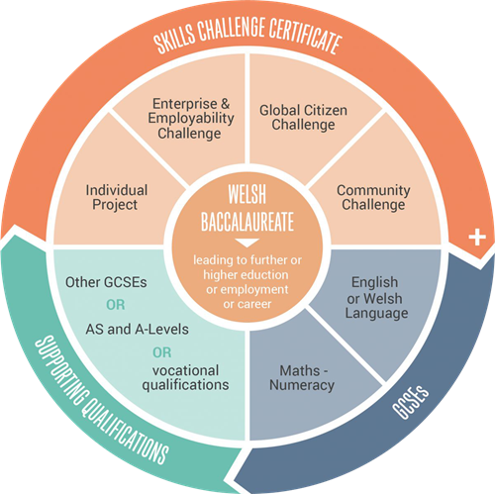
Course Description & assessment
Community Challenge – 15%
Plan, volunteer & reflect on an experience you choose around your passion.
Global Citizenship – 15%
Research, debate & reflect on a global issue of your choice.
Enterprise & Employability – 20%
Develop & run your own business raising money for charity.
Individual Project – 50%
Research & create an individual project around a topic chosen by you!

Slide 4
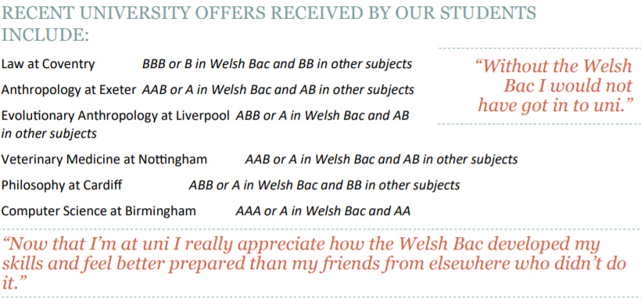
Career progression & subject combinations

Slide 5
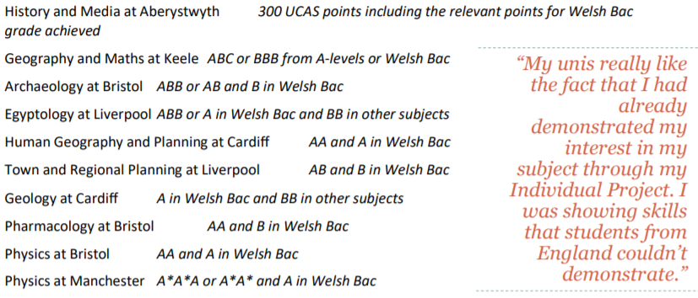
Career progression & subject combinations

Slide 6
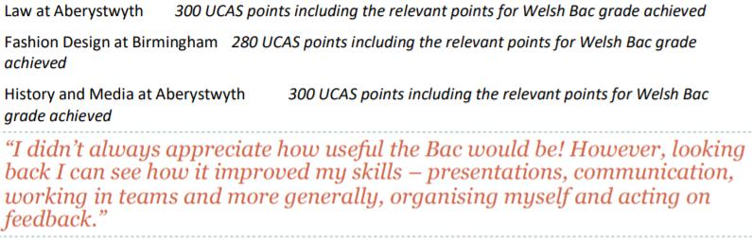
Career progression & subject combinations

